Slide 1

PHASE 3 PROJECT
PRESENTED BY: ABDIHAKIM S MOHAMED
OCTOBER 2023

Slide 2
Problem statement
The objective of this project is to analyze SyriaTel's customer data to identify patterns contributing to customer churn, with the ultimate goal of minimizing financial losses associated with customer turnover.

Slide 3
Data Used for the analysis
SyriaTel Churn Data set downloaded from kaggle.

Slide 4
Method
Loaded the data using python modules to read the data
Data Understanding and Cleaning
Data visualization for insights
SMOTE
Logistic Regression Classifier
Optimizing Logistic Regression with GridSearchCV
Random Forest Classification Algorithm.

Slide 5
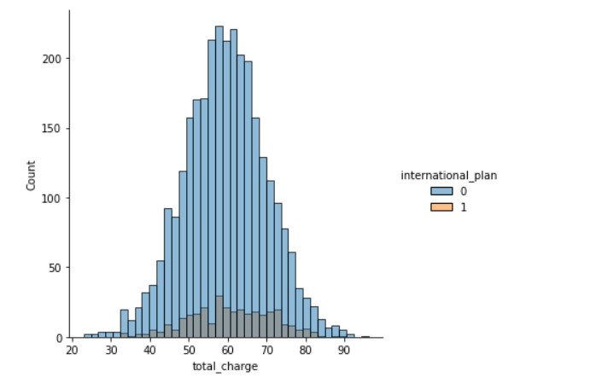
Count vs Total_Charge
- Graph of count vs total_charge showing a normal distribution.
1

Slide 6
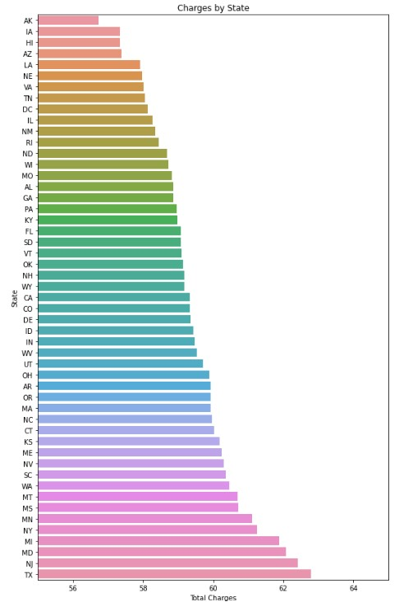
1

Slide 7
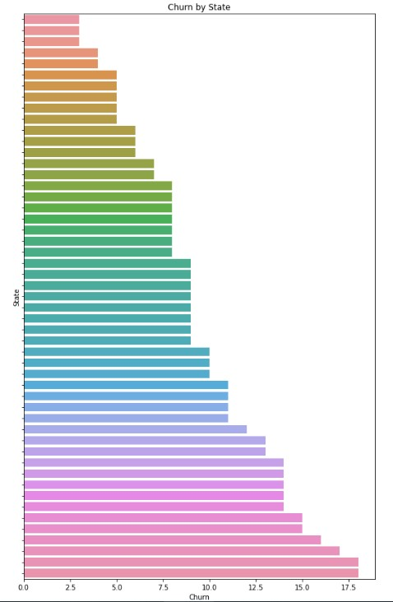
1

Slide 8
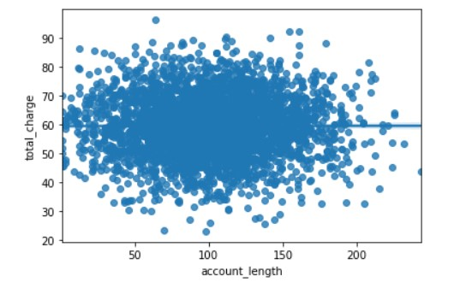
Scatter Plot Analysis
1

Slide 9
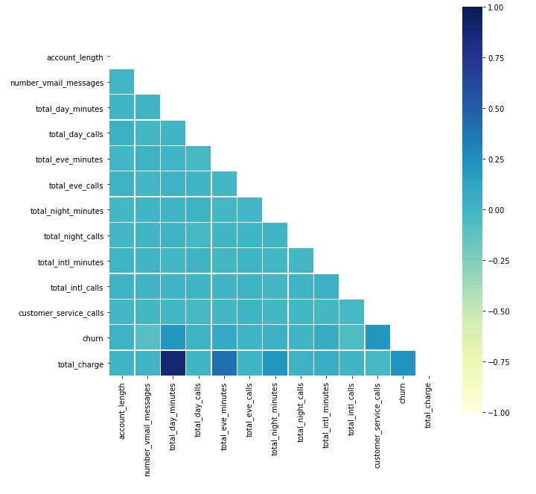
Correlation Matrix
1

Slide 10
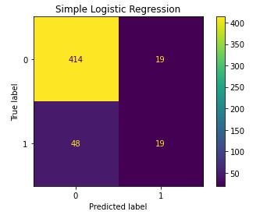
1

Slide 11
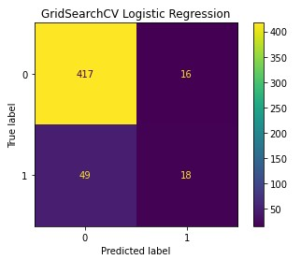
1

Slide 12
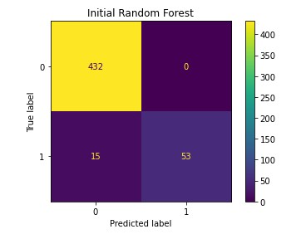
1

Slide 13
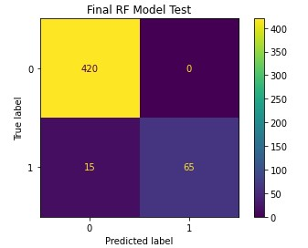
1

Slide 14
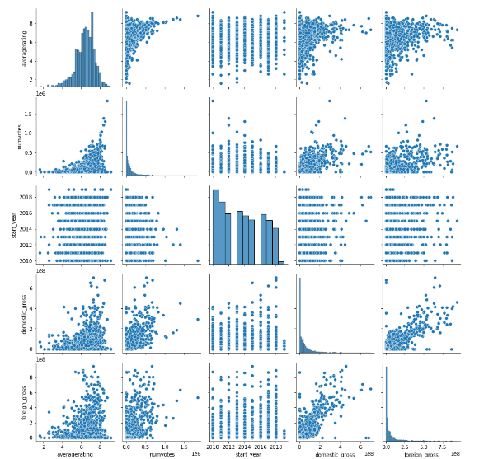
Scatter plot identifying potential correlation between variables
1

Slide 15
Conclusion
The Random Forest Classifier, excluding location data, was chosen as the final model due to its capability to maximize recall in predicting customer churn.
A significant 42% of SyriaTel's subscribers on the International Plan terminated their contracts, signaling dissatisfaction with international offerings.
Existing data suggests that a promotional campaign was active during the studied period, inferred from the total charges distribution and account tenure of churned users.
The frequency of customer service calls is a paramount determinant of customer satisfaction. Multiple calls from a single customer within a billing cycle indicate dissatisfaction.

Slide 16
Recommendations
Reevaluate the International Plan:
Offer enhanced discounts for international calls to subscribers, aiming to improve satisfaction and retain customers.
Continue Marketing Efforts:
- Launch a trial voicemail package for high-risk customers.
- Provide monthly charge discounts to high-risk customers, emphasizing the significant role of the overall charge in customer decisions.
- Introduce loyalty incentives for long standing customers to counteract competitors' attractive deals.

Slide 17
Recommendations
3. Enhance Customer Service Quality:
- Train agents to reduce the frequency of customer calls and address concerns effectively.
- Introduce diverse account management platforms, such as mobile, online, and automated telephonic services, to foster self-service and reduce dependency on service staff.
4. Implement and Evaluate:
Roll out the suggested promotional campaigns and service improvements. Post-implementation, conduct an assessment to measure the impact of these initiatives, validating the efficacy of the strategies in line with the model's predictions.

Slide 18
Thanks

